Slide 1
Video Games Store
Fundamentals Of Web Design
Belal Elhalles - 202011235

Slide 2
About the Project
SWIFTY
•My project is a Video Games store that sells different video games and consoles on different platforms. It has a Home Page, About Me page, Cart, and the products page which has three different sections, PlayStation, Xbox and Nintendo.

Slide 3




Color Scheme
Color | Hexadecimal Value | Used For
 | #000000 & #FFFFFF | Font
 | #124272 & #5EA4F3 | Buttons
 | #FFFFF | Background
 | #124272 | Header
 | #124272 | Footer

Slide 4
Fonts Used
The fonts mainly used are: Arial, Sans-Serif, Monospace, Gothic, including all their variations.

Slide 5
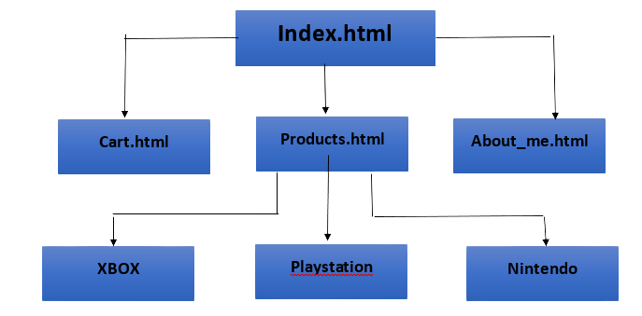
Page Hierarchy

Slide 6
Pages
Home
Products
About Me
Cart
All pages contain a header which has access to all the pages, a search bar and a currency option. All the pages have a footer which has the contact us information. Like, GitHub, Gmail, etc.

Slide 7
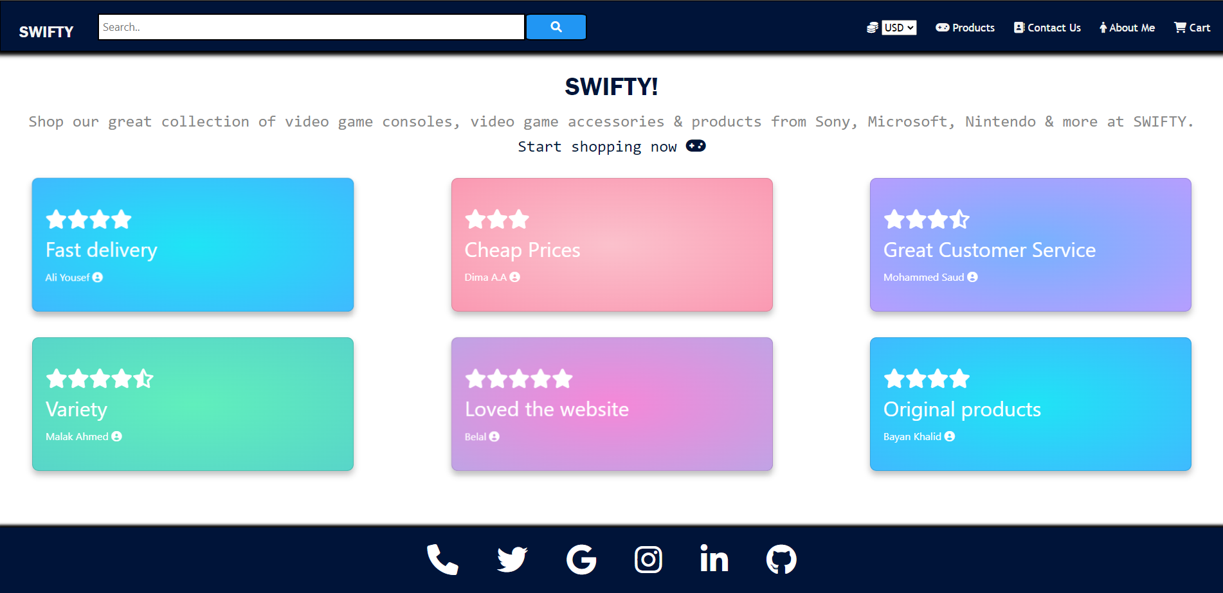
Home Page
The home page has a brief introduction about the shop with a “Start shopping now” button. There are multiple positive reviews to persuade the customer.

Slide 8
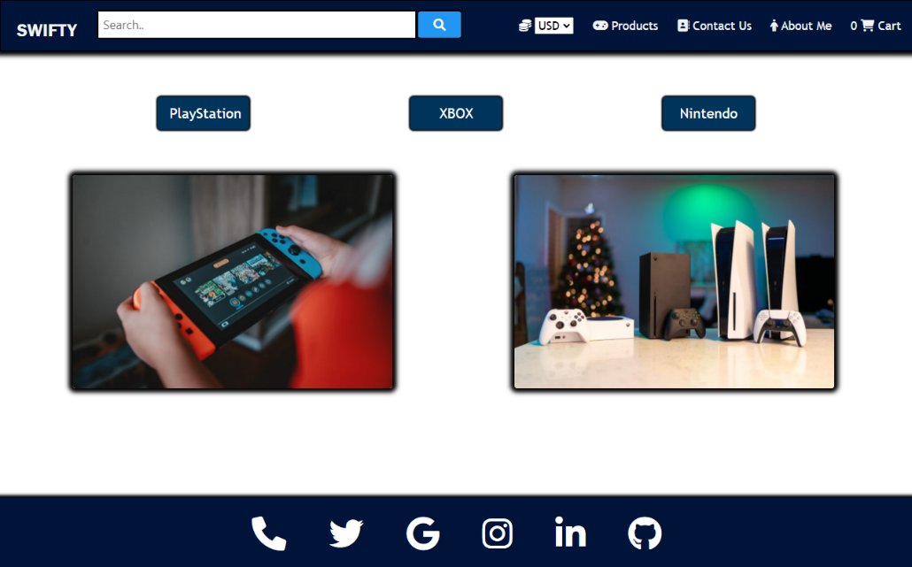
Products Page
The products Page has three buttons, each button displays products from each section using JS. There are two pictures for the companies we deal wtih

Slide 9
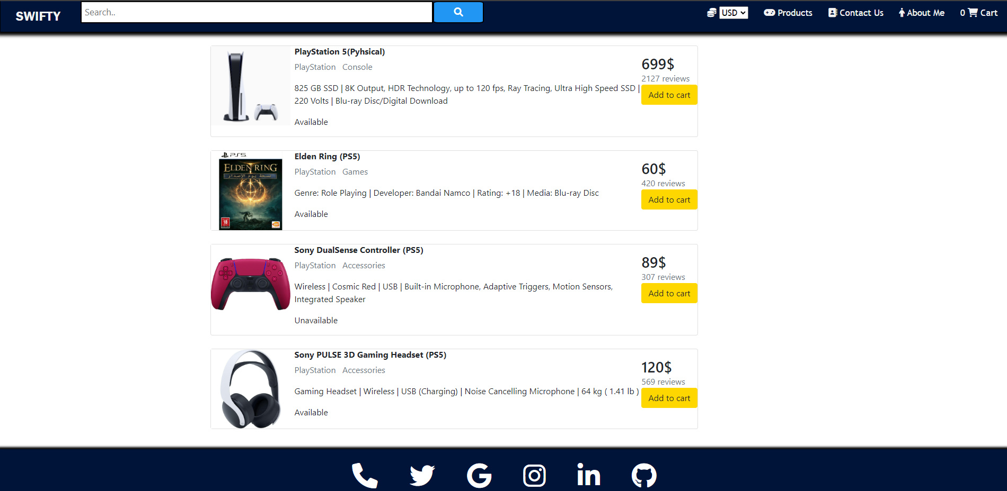
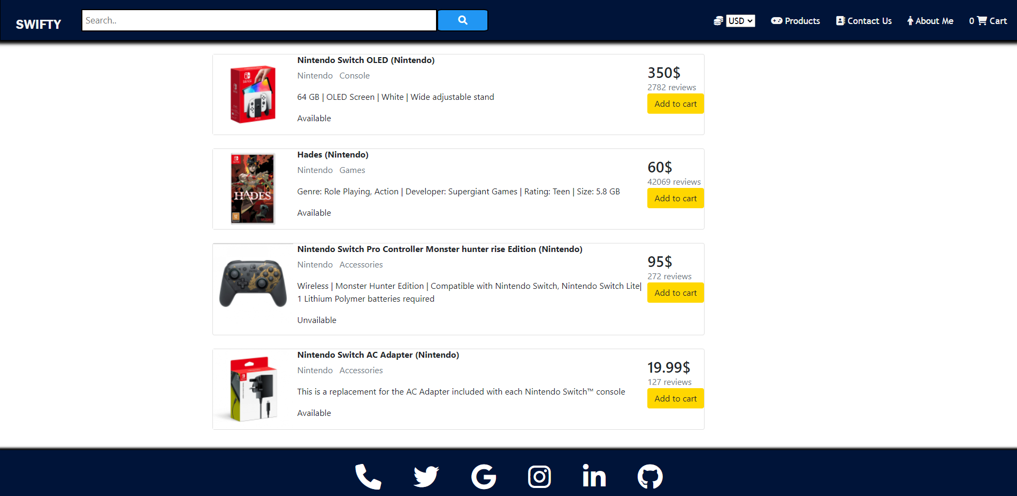
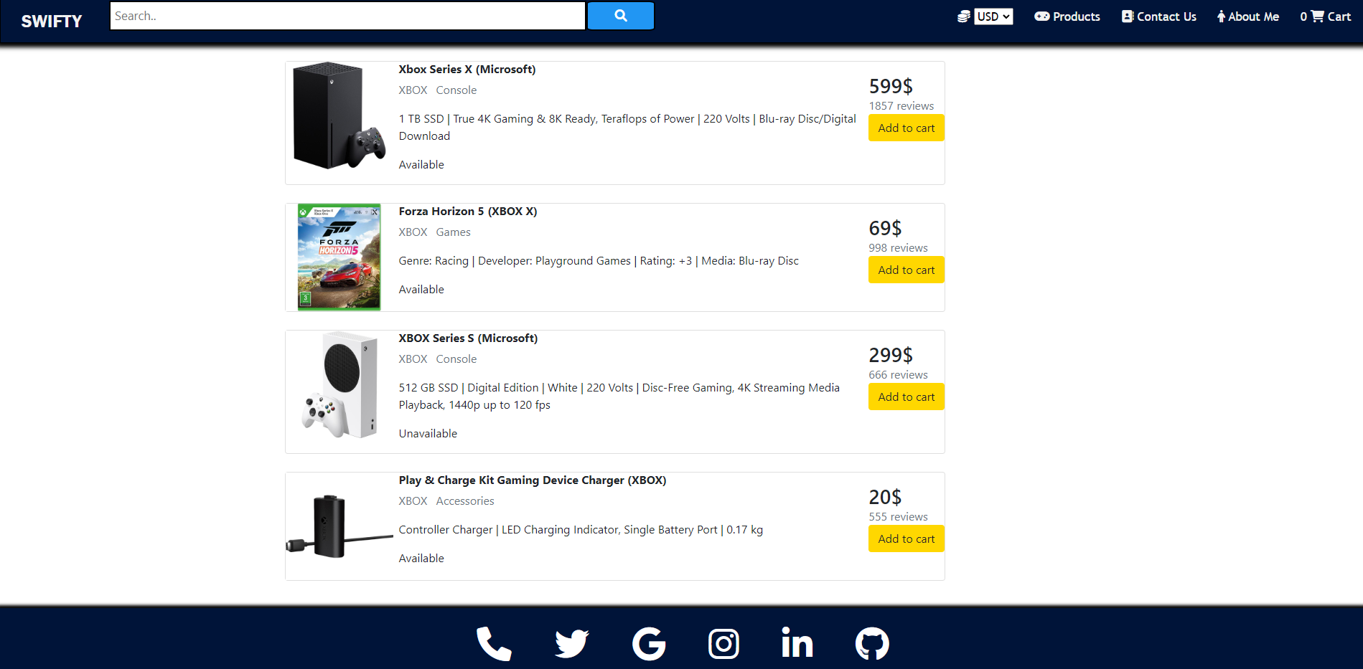
Products

Slide 10
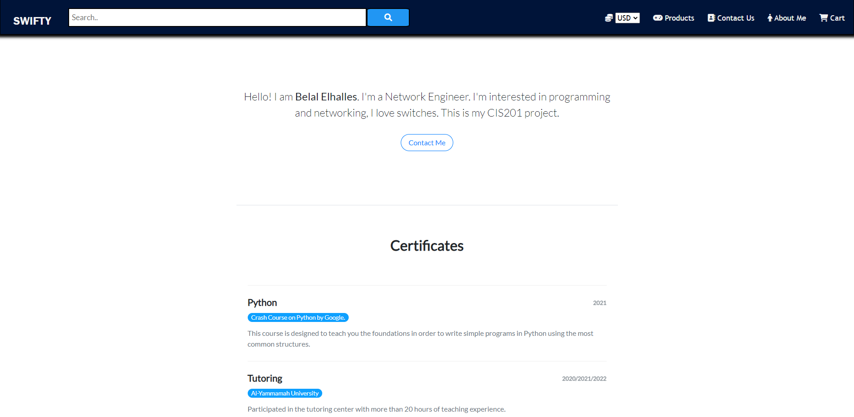
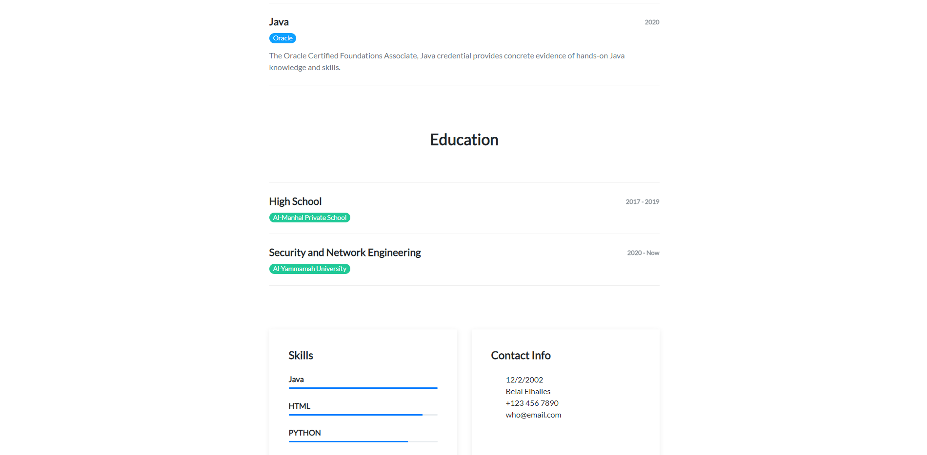

About Me Page
This page is my portfolio, It has all the important information about me

Slide 11
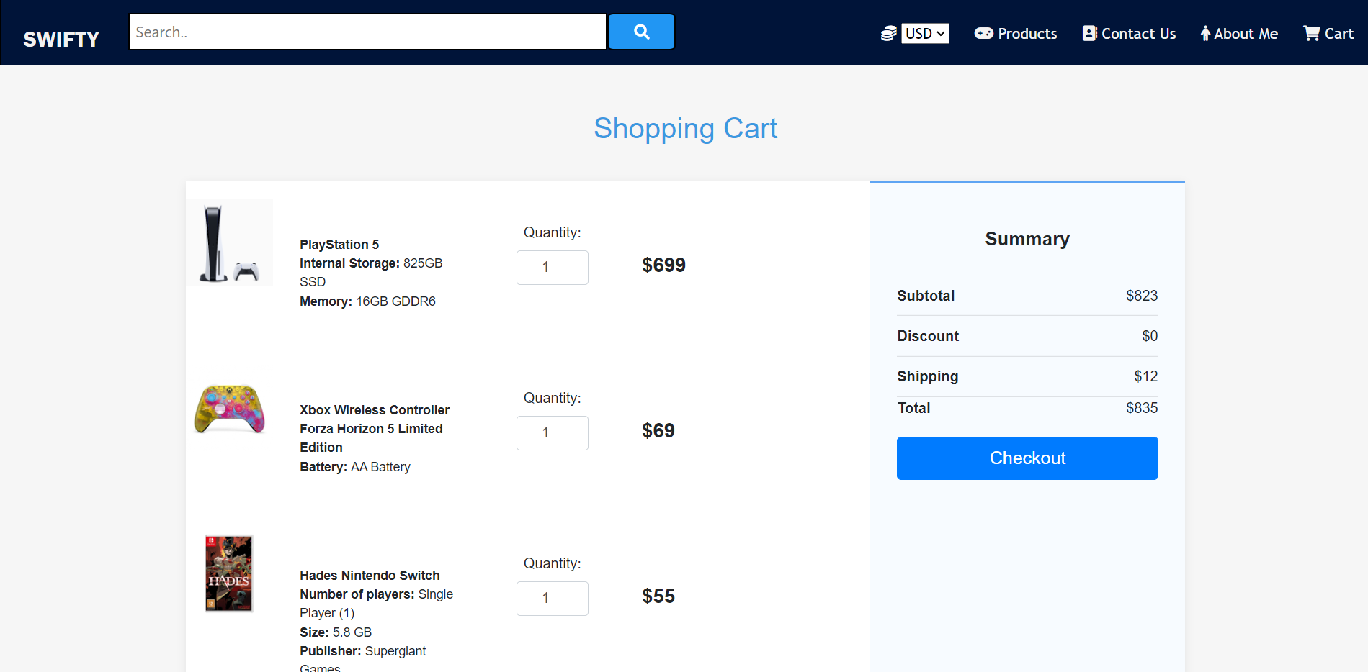
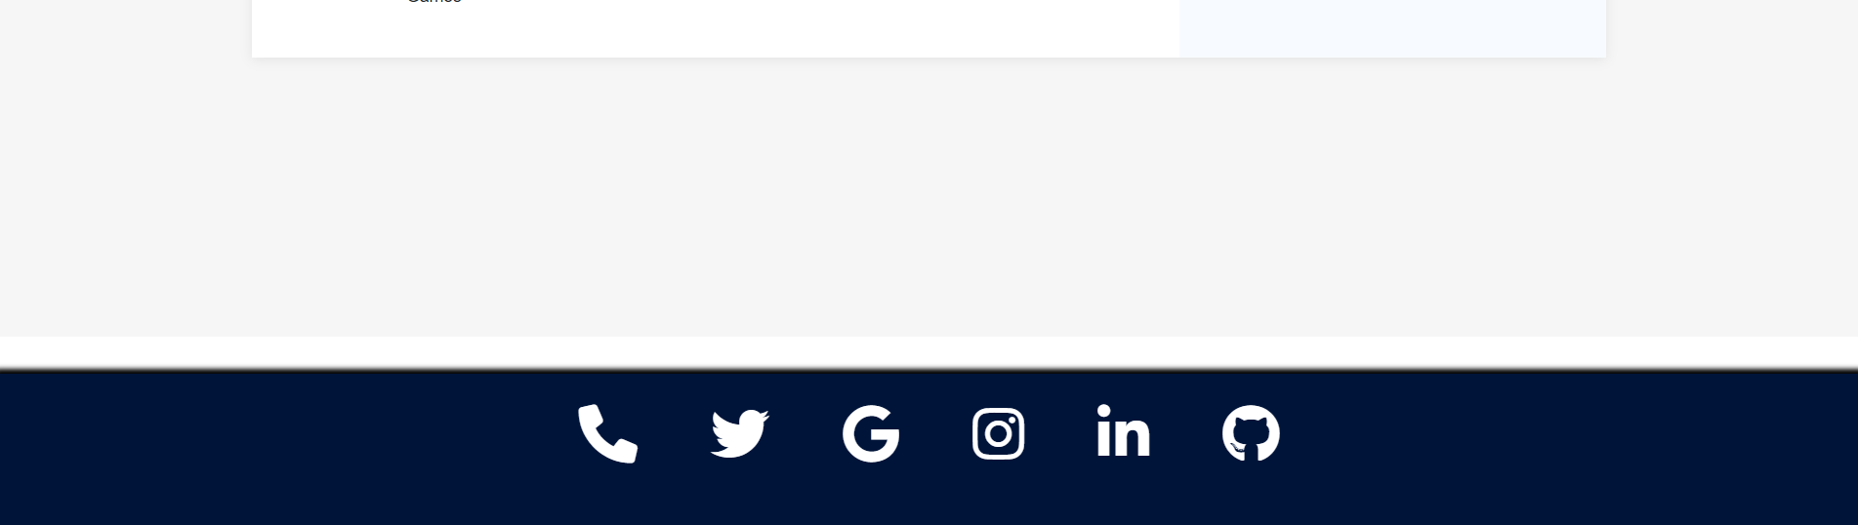
Cart Page
The Cart Page has three different products displayed, one from each section. You could modify the quantity; you can see a brief description of each product. There is a summary with the subtotal then the total including the discounts and shipping fees. Finally, a Checkout button.

Slide 12



External Links
JavaScript
CSS
BooStrap
<script src="../src/js/JavaScript.js"></script>
Products Display code + Cart counter
<link rel="stylesheet" href="../src/css/styles.css"> Header/NavBar +products css
<link rel="stylesheet" href="../src/css/index.css"> Home Page css
<link rel="stylesheet" href="../src/css/footer.css"> Footer
<link rel="stylesheet" href="../src/css/abtme.css"> About me CSS
<link rel="stylesheet" href="../src/css/cart.css"> Cart CSS
<link rel="stylesheet" href="https://stackpath.bootstrapcdn. com/bootstrap/4.3.1/css/bootstrap.min.css" crossorigin="anonymous"> <script src="https://kit.fontawesome.com/81d205404b.js"crossorigin="anonymous"></script>

Slide 13
THANKS!

